Slide 1
Quality Management System
(FSOFT QMS)
Instructor: PhuongTTK
FHCM QA Manager

Slide 2

Training Objectives
  After the course, you will:
    Aware of Quality
    Aware of ISO and CMMI
    Understand the overall Fsoft QMS
    This course is for all new comers
    Duration: 45’

Slide 3

Training Agenda
  1. What is Quality?
  2. What is ISO and CMMI?
  3. Introduction to Fsoft QMS
  4. Q&A

Slide 4

FPT’s Quality Policy
“FPT makes efforts to satisfy its customers based on good knowledge and try one’s best to meet their need with continuously increasing devotion and capability.
  CÔNG TY NỖ LỰC LÀM KHÁCH HÀNG HÀI LÒNG TRÊN CƠ SỞ HIỂU BIẾT SÂU SẮC VÀ ĐÁP ỨNG MỘT CÁCH TỐT NHẤT NHU CẦU CỦA HỌ VỚI LÒNG TẬN TỤY VÀ NĂNG LỰC KHÔNG NGỪNG ĐƯỢC NÂNG CAO.”
Quoted from Fsoft Policy document

Slide 5

FSOFT’s Quality Objective
“TO DELIVER REQUIRED SOFTWARE PRODUCTS IN TIME MANNER ACCORDING TO THE PROJECT PLANS ACCEPTED BY CUSTOMERS.
Bàn giao đúng hạn sản phẩm đáp ứng yêu cầu khách hàng.”
Quoted from Fsoft Objective document

Slide 6
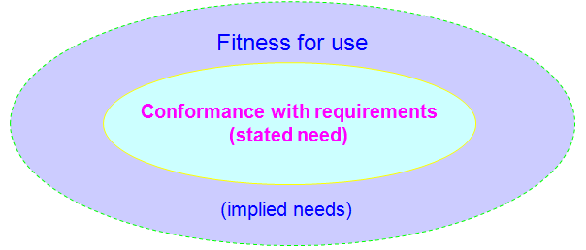

What is Quality?
ISO 9000 said
“Degree to which a set of inherent characteristics fulfills requirements”
CMMi said
“The ability of a set of inherent characteristics of a product, product component,
or process to fulfill requirements of Customers”
Chất lượng là “đáp ứng yêu cầu khách hàng” và “phù hợp để sử dụng”

Slide 7
What is Quality?
PEOPLE
QUALITY
TECHNOLOGY
PROCESS
  Process
    Has the advantage of being able to replicate a product time and time again. Even in data processing, the process is able to replicate similar products with the same quality characteristics.
    Quality is achieved through processes.
  People
    Your workforce, on the average, is as “good” as it is trained to be.
    Working harder is not the answer. Working smarter, through process, is the answer.
  Technology
    Technology applied without a suitable roadmap will not result in significant payoff.
    Technology provides the most benefit in the context of an appropriate process roadmap.

Slide 8
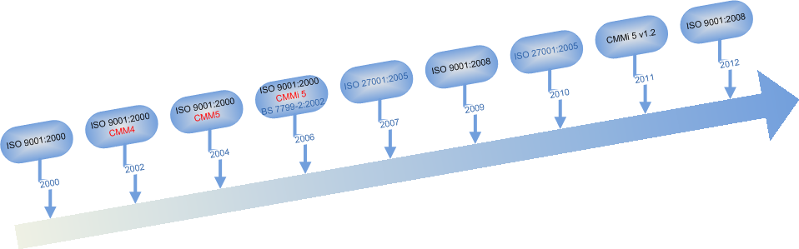
Quality & IS Management Certificates
Notes:
  CMMI Capability Maturity Model Integration
  ISO International Organization for Standardization
  BS7799 British Standard (Security standard)

Slide 9
ISO 9000
What is ISO?
ISO (International Organization for Standardization)
  Founded in 1947 - Geneva, Switzerland.
  The world’s largest developer of voluntary International Standards.
ISO 9000
  An international set of standards for quality management applicable to a range of organisations from manufacturing to service industries.
  There are many standards in the ISO 9000 family, including:
    ISO 9001:2008 - sets out the requirements of a quality management system
    ISO 9000:2005 - covers the basic concepts and language
    ISO 9004:2009 - focuses on how to make a quality management system more efficient and effective
    ISO 19011:2011 - sets out guidance on internal and external audits of quality management systems.
Notes:
ISO là cơ quan thiết lập tiêu chuẩn quốc tế bao gồm các đại diện từ các tổ chức tiêu chuẩn các quốc gia. Tổ chức này đã đưa ra các tiêu chuẩn thương mại và công nghiệp trên phạm vi toàn thế giới
ISO 9000
Bộ tiêu chuẩn về Hệ thống quản lý chất lượng
Đưa ra các nguyên tắc về quản lý
Tập trung vào việc phòng ngừa / cải tiến
Chỉ đưa ra các yêu cầu cần đáp ứng
Áp dụng cho tất cả các loại hình tổ chức
Việt Nam là thành viên chính thức năm 1977
ISO <nnnnn:yyyy>, “nnnnn” là số tiêu chuẩn, “yyyy” là năm công bố
Chỉ có ISO 9001 được dùng để làm căn cứ đánh giá và cấp chứng chỉ cho doanh nghiêp nào muốn lấy Chứng chỉ ISO.
ISO 9000 và ISO 9004 là tài liệu bổ trợ, cung cấp thông tin sâu hơn để giúp doanh nghiệp tham khảo để tự duy trì và cải tiến hệ thống QLCL của mình. ISO 19011 dùng để đào tạo và cấp chứng chỉ cho chuyên gia đánh giá

Slide 10
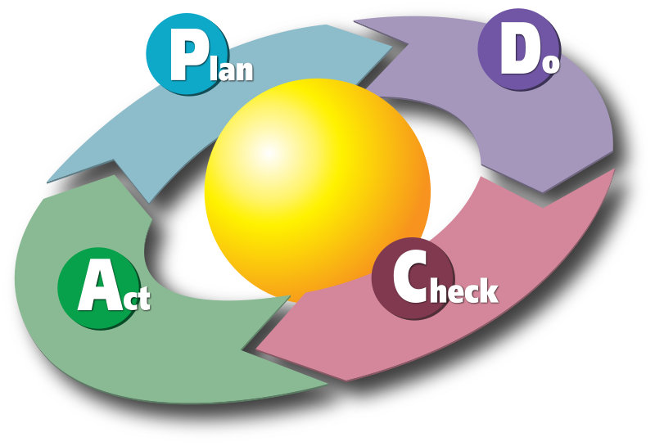
Quality Cycle
5W & 1H
  What is “PDCA”
PDCA (Plan–Do–Check–Act) is an iterative four-step management method used in business for the control and continuous improvement of processes and products.

Slide 11
What is CMMI?
CMMI (Capability Maturity Model Integration) is a process improvement maturity model for the development of products and services. It consists of best practices that address development and maintenance activities that cover the product lifecycle from conception through delivery and maintenance.
CMMI vs. ISO
ISO | CMMi
Là các tiêu chuẩn | Là mô hình (không phải tiêu chuẩn)
Đưa ra các yêu cầu, quy định về những điểm cần phải làm (what to do) | Cung cấp các hướng dẫn và kinh nghiệm thực tế, chỉ ra việc đó nên làm thế nào (how to do)
Bao gồm hầu hết các quy trình chủ chốt, áp dụng cho mọi ngành nghề | Giới hạn cụ thể, gần gũi với các công việc đặc thù, có liên quan đến phần mềm

Slide 12
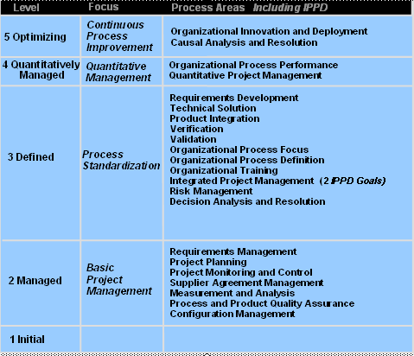
CMMI Framework
22 Process Areas

Slide 13
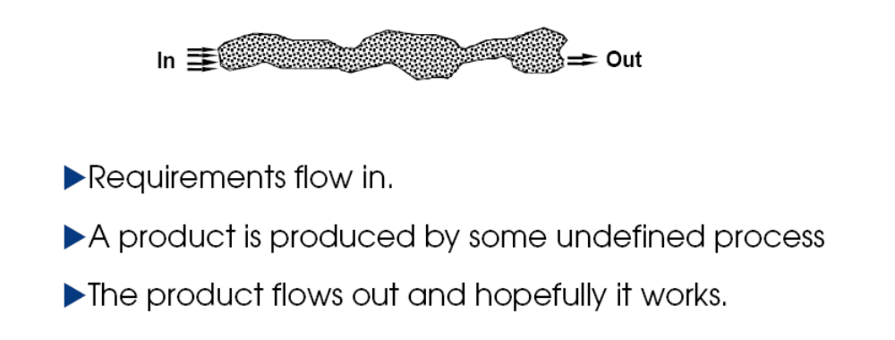
CMMI Framework: The Maturity Levels
The Maturity Level 1 - Initial

Slide 14
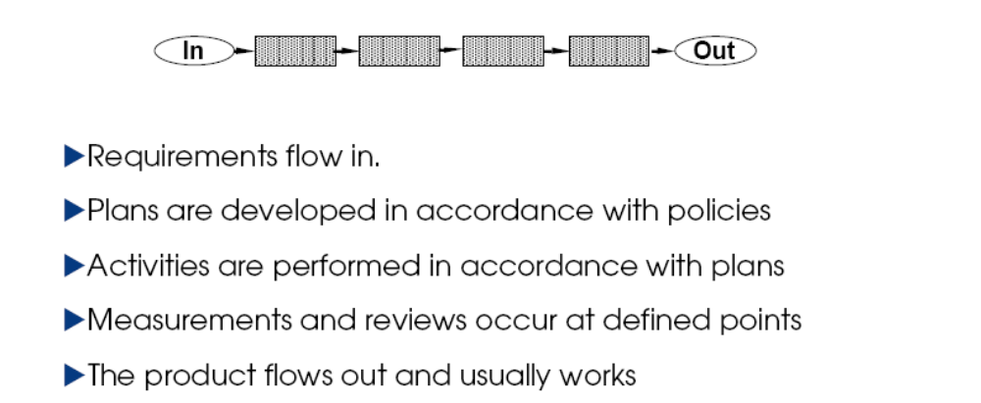
CMMi Framework: The Maturity Levels
The Maturity Level 2 - Managed

Slide 15
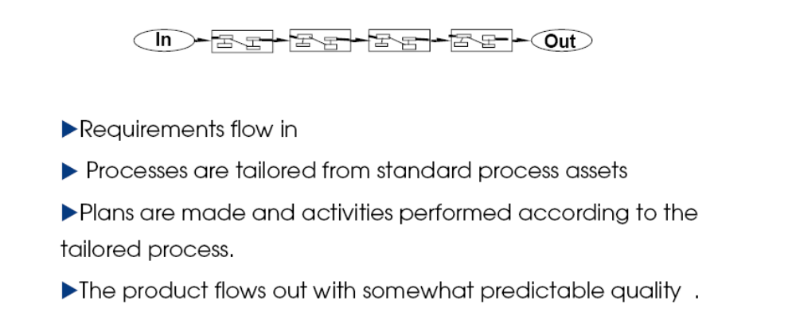
CMMI Framework: The Maturity Levels
The Maturity Level 3 - Defined

Slide 16
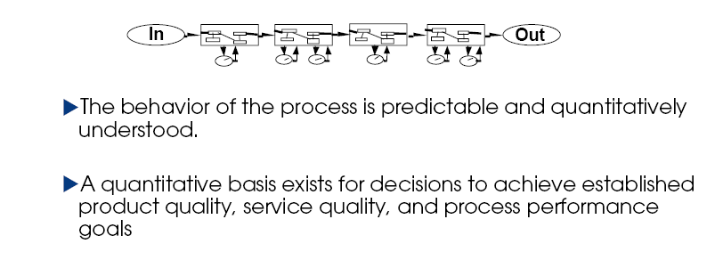
CMMI Framework: The Maturity Levels
The Maturity Level 4 – Quantitatively Managed

Slide 17
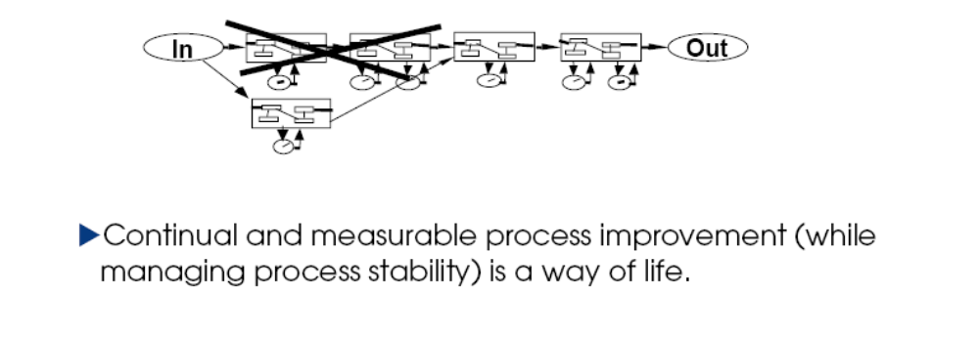
CMMI Framework: The Maturity Levels
The Maturity Level 5 – Optimizing

Slide 18
ISO & CMMI
Why does FSOFT apply those?
Desire to follow standards and practices on the production
  ISO is for general production
  CMMi is specific for software development
Are qualified and certified world-wide
Defined in the FSOFT Policy

Slide 19
FSOFT QMS Structure
  Quality Document System (QDS)
  Improvement Proposal (IP)
  Best Practices (SW Process Assets, SW Process Database)
  PCB and Norms (Process Capability Baseline are measurement of Performance for the organization's set of standard processes at various levels of details as appropriate: Leakage, Customer satisfaction, productivity, Timeliness, Effort Efficiency, Defect rate, …. )
  Tools (FSOFT’s IP Tools)

Slide 20
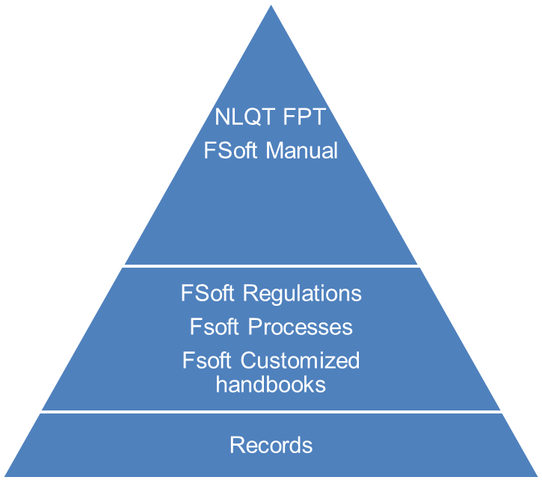






FSOFT QDS Level
The QDS comprehend and include all FSOFT’s quality activities and requirements of ISO 9001, CMMI5, ISO 27001.
Stake holders
Input: Requirement
Fsoft Quality Document System
Stake holders
Output: Satisfaction
Share holder
Share holder
Customer
Customer
Leader
Leader
Staff
Staff
Partner
Partner
Community
Community

Slide 21
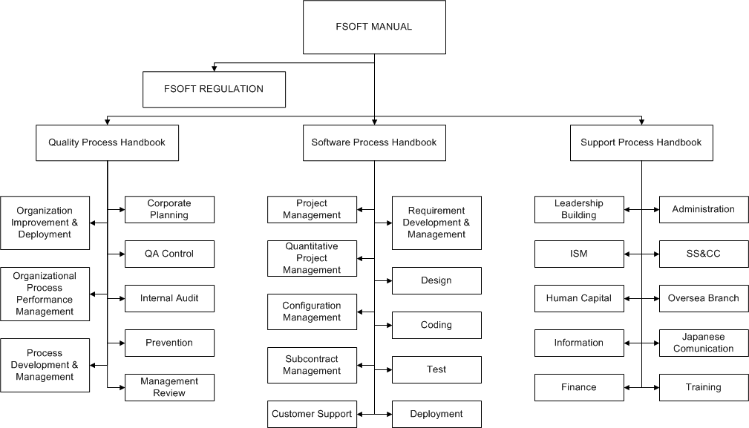
FSOFT QDS Structure

Slide 22
Quality Handbook Structure
Process is documented in process handbook. Process handbooks support Fsoft manual to set standards for employees, including:
  Process definitions (-QT…)
  Job description (-CV/…)
  Guideline (-HD/…)
  Checklist (-CL/…)
  Template (-BM…)
  Technical standards (-QD)
  List, external references (-DM/…)
  For example: 01e-QT/TT/HDCV/FSOFT
Quality Document name follows convention:
<Type of document>_<Name of Document>
  For example: Process_Coding
Quoted from Guideline_Marking and Document Presentation
Notes:
List, external references (national and international standards)

Slide 23
FSOFT QDS
Responsibility
Responsibility:
  Access right: All Fsofters
  Request for change: All Fsofters
  Responsible for maintain, control and update QDS: QAHO
Copyright of the QDS:
  Sign and follow the Non Disclosure Agreement (NDA) on security.
  Written permit of the QA Manager.

Slide 24
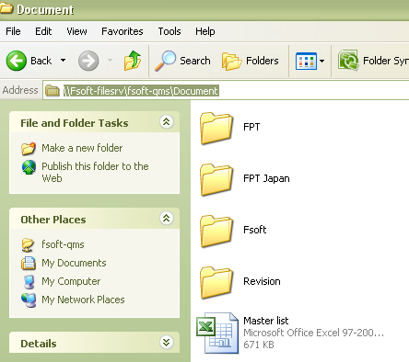
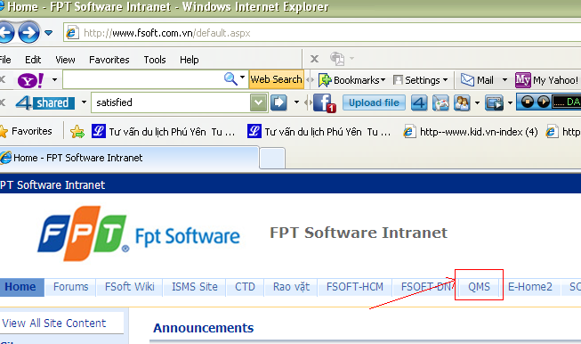
FSOFT QDS
How to refer?
Placed in:
  File server:
  \\Fsoft-filesrv\fsoft-qms\Document
  FSOFT Intranet:
  http://qms.fsoft.com.vn/default.aspxv
Support Hotline:
  E-mail: 108.QA@fsoft.com.vn
  Calllog to QAHO

Slide 25
What is IP?
  IP = Improvement Proposal
    Suggestion - SUG
    Change request – CR
    IP – ranked as A, B, C, D and E
  How to evaluate “IP”?
    Scope (process, number of effected people, customer, level)
    Benefit (Improve quality, Reduce time, Improve productivity, Improve CSS, Business, Procedure, …)
    Necessary (Priority)
    Cost (Number of people to develop & deploy, Complexity, Time to develop & deploy, Money, …)
    Willingness (brand new creative or inherited from the existence, deliverables of SUG submitted on time, SUG submitter's job, SUG follow FSoft's IP Procedure, readiness of reference documents …)

Slide 26

What can we get?
IP rank | IP point | IP reward
A | 50 | 10.000.000 VND
B | 30 | 3.000.000 VND
C | 20 | 1.000.000 VND
D | 10 | 500.000 VND
E | 5 | 100.000 VND
Valid SUG / CR | 0.5 | 20.000 VND

Slide 27

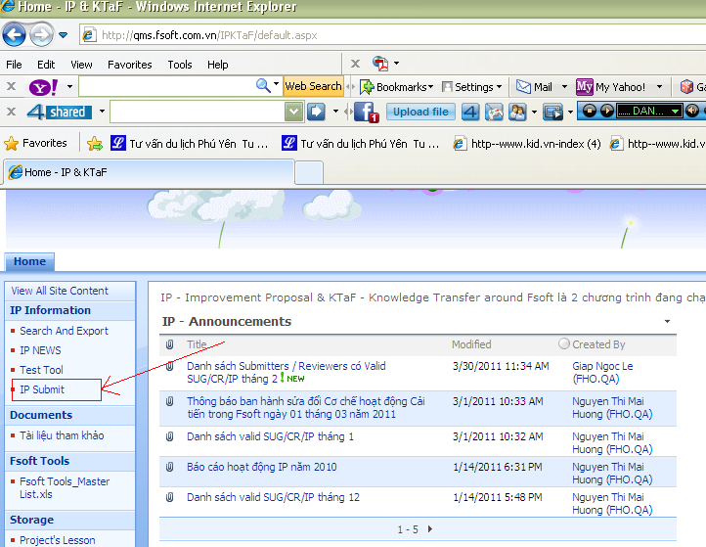
How to submit?
  Fsoft Intranet: = = = = = = = > http://qms.fsoft.com.vn/IPKTaF/default.aspx
  E-mail:
  All: IP@fsoft.com.vn;
  108.QA@fsoft.com.vn
  HCM: IP.HCM@fsoft.com.vn
  DN: phongnh@fsoft.com.vn

Slide 28

Q & A

